Slide 1


QUAKER SERVICE AUSTRALIA
Climate change issues addressed in its projects

Slide 2
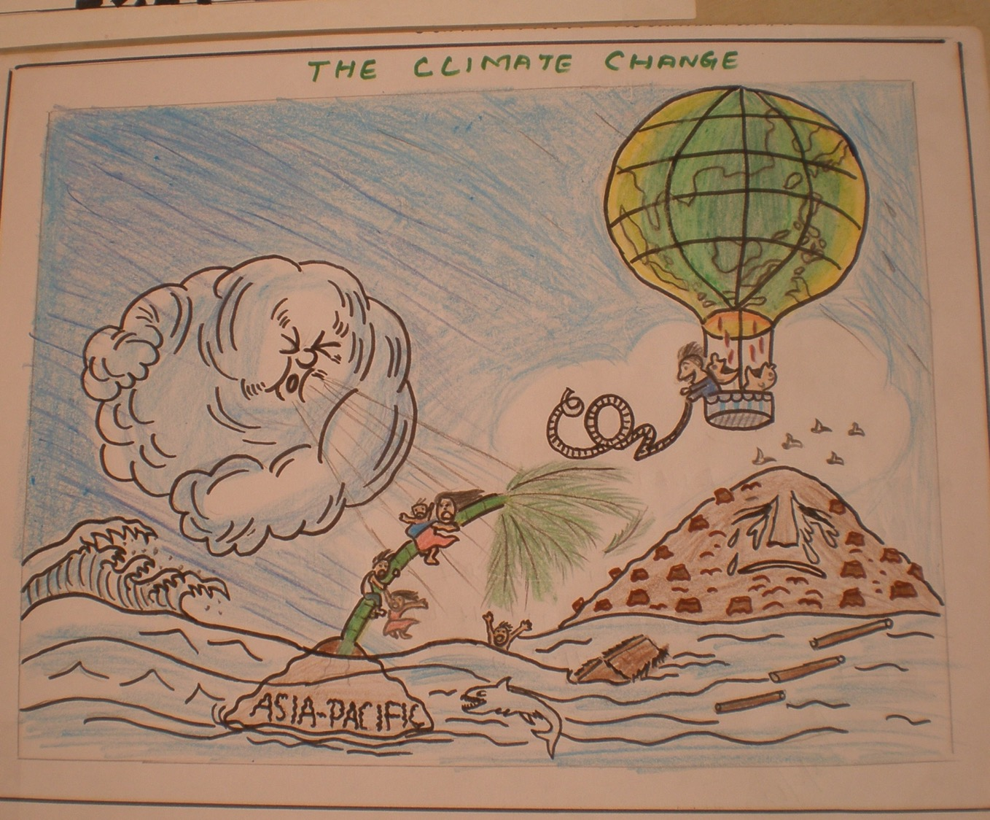
A student in Tamil Nadu drew his understanding of what is climate change

Slide 3
The IPCC defines climate change as
the change in the state of the climate that can be identified by changes in the mean and/or the variability of its properties, and that persists for an extended period, typically decades or longer. 2013
Every week a new country or corporation announces a target to achieve ‘net zero’ carbon emissions.... [However].... Without clear definition, they risk being dangerous distractions that gamble with the planet’s future’. Oxfam August 2021

Slide 4
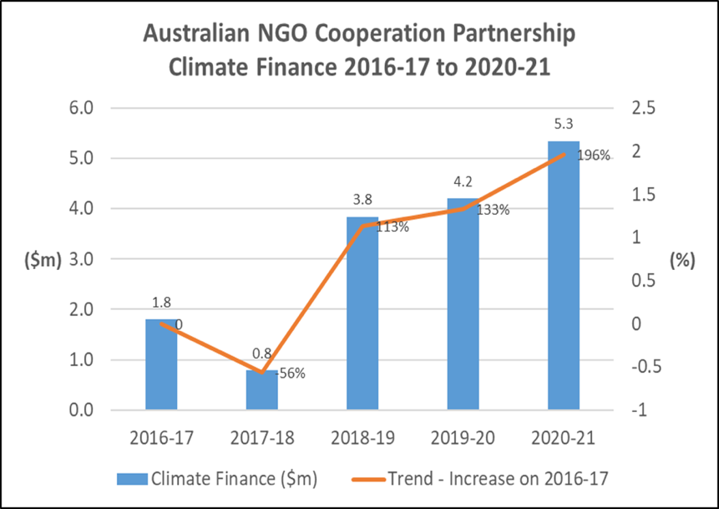
ANCP Climate Change Contribution
Australian NGOs are playing an increasingly important role in Australia’s climate change action with our developing partners.
This is reflected in the ANCP contribution to climate finance over time.

Slide 5
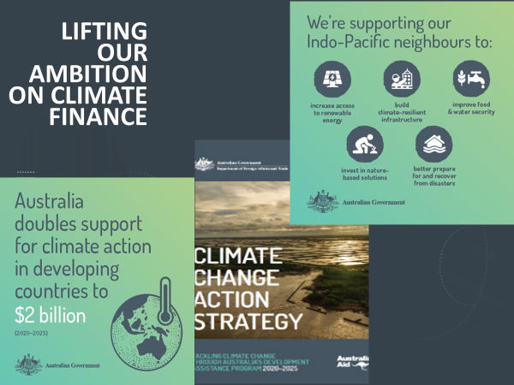

Slide 6
Addressing poverty and inequality cannot be effective without addressing global climate and environmental impact.
Integrating the co-benefits of climate and biodiversity gains into livelihood and socio-economic development will be essential to all climate resilient future programming.
Climate change will have a greater impact on the poorest and most marginalised people around the world, in particular women and girls.
QSA includes assessment on climate and environmental risks in all of its projects.

Slide 7
In 2007, QSA asked project partners what they had noticed about changes to their climate and situation
Cambodia | 2007 survey | 30 years before
 | Use chemical fertilisers Rice yield 1-2 tons, occasionally up to 5 | Fertiliser from cow manure only I hectare of rice regularly yielded 3-4 tons
AGRICULTURAL ACTIVITIES – anecdotal

Slide 8
AGRICULTURAL ACTIVITIES – anecdotal
India | 2007 survey | 30 years before
 | No forests exist People have fewer animals Grow and use only rice and peanuts Pesticides used a lot Chemical used People now use tractors | Patches of forest near the village Each household would have a big herd or up to 50 cattle Grow and eat traditional grains – corn, millets, dhal Compost and neem used for agricultural use Used bullocks for pulling a plough

Slide 9
Uganda | 2007 survey | 30 years before
 | Land fragmented as population increases Lack of space and fodder restricts number of animals Over-cultivation is taking place Over use of chemicals No cotton grown in the region Better market for agricultural produce Traditional crops not grown very much now though foods well liked | Spacious land for individuals Had large herds of animals as land was plentiful Soil was fertile as was regularly fallow None or very few chemicals used Cotton was an important cash crop Had high yields from farming but no markets Crops such as waju, amaboga (type of marrow), empande (similar to groundnuts), pigeon peas.

Slide 10
This information, although anecdotal, was used to make changes to training courses being provided.

Slide 11
Land-based carbon removal methods
Enhancing carbon sequestration in forests
Afforestation / reforestation
Enhancing soil carbon
Biochar
Bioenergy with carbon capture and storage

Slide 12
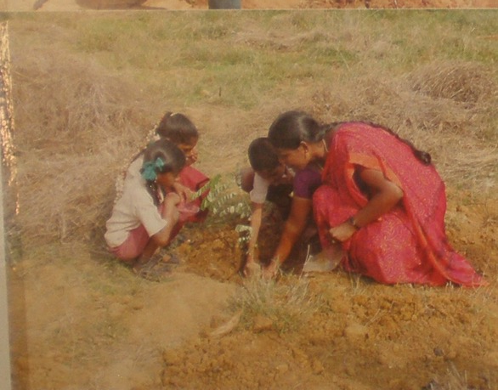
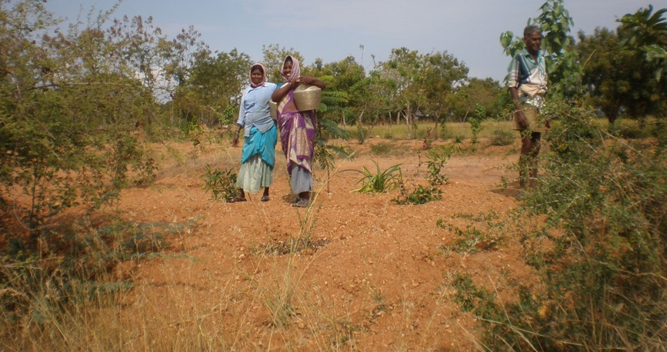
Enhancing carbon sequestration in forests
Protecting existing forests
Restoring degraded forests
Improving forest management
Protection of biodiversity
Pitchandikulam Bio Resource Centre, Tamil Nadu, South India

Slide 13
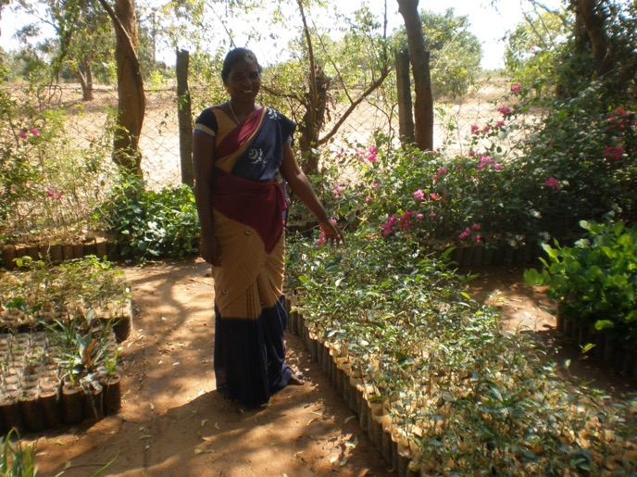
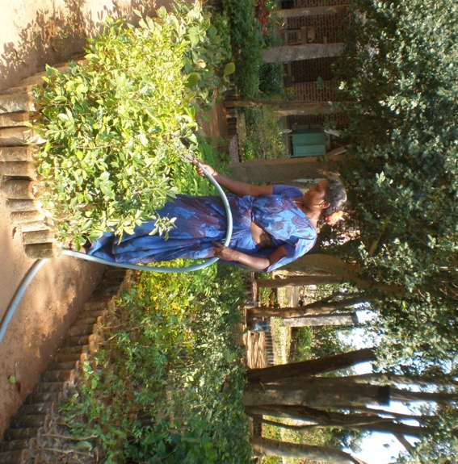
Afforestation / reforestation
Afforestation - planting forests of indigenous trees on lands where they did not previously grow
Reforestation – planting forests in areas that previously had forests.

Slide 14
Reforestation may result in large scale tree plantations, as commercial monoculture. Since July 2021 PBRC planted close to 26,000 indigenous tree seedlings, Vasandham Society 7,500 both in forest areas, and St Jude Family Projects has enabled the planting of 6,335 tree seedlings domestically, by women, youth and children at the three schools. Of course simply planting more trees is not the answer, they need to be watered and tended until well established, and given a long life in the ground so projects need to include a component of the budget for maintaining the trees.

Slide 15
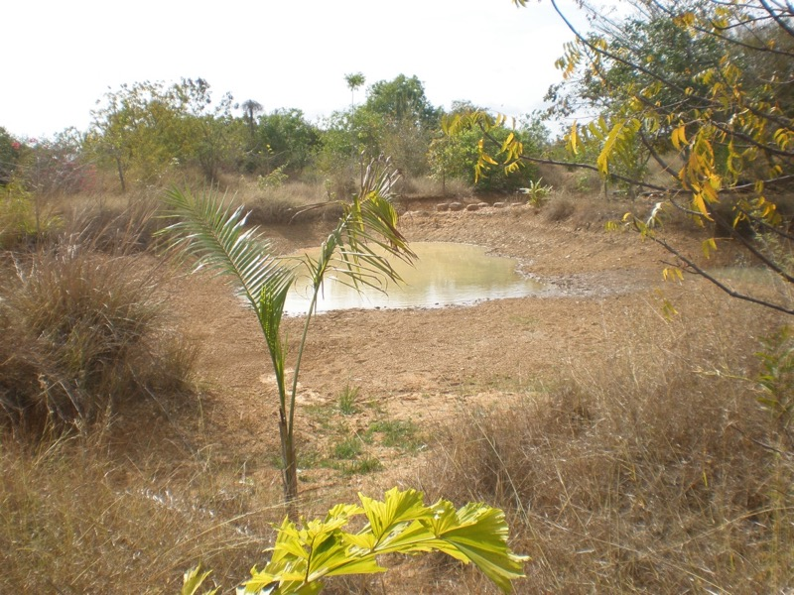
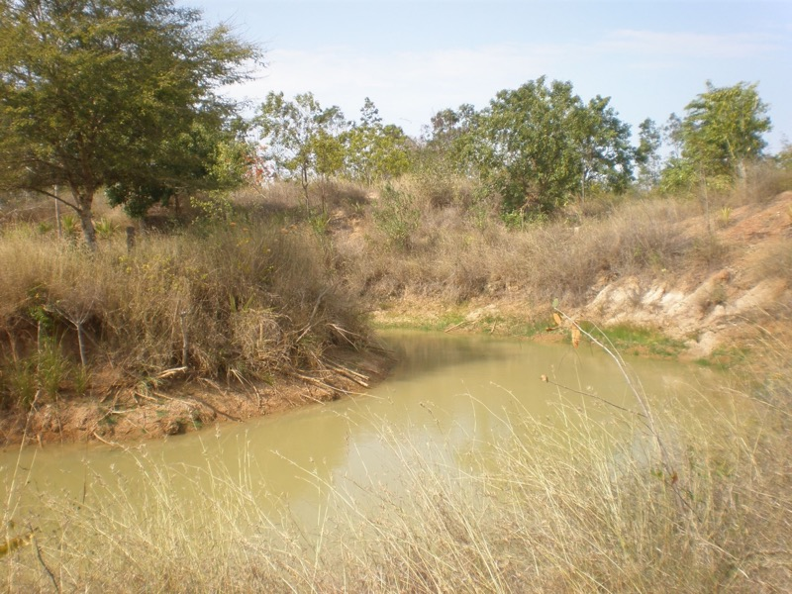
Afforestation and reforestation
Links to water management
Address timber use, such as fuel efficient stoves
This area of reforestation is 35 acres of former farming land. The first task was to analyse water flow during the rainy season, and as a result of that, ponds and water channels were dug to hold water on the land for use later in the drier months, and then trees were planted

Slide 16
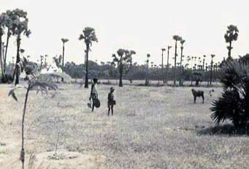
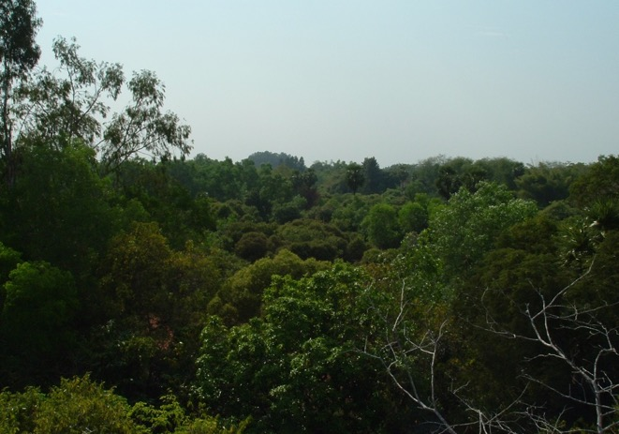
Same site today - 70 acres part of Auroville, an intentional International community with UNESCO support
Pitchandikulam Forest in early 1970s. The land was denuded except for a few palm trees, and had been used for dry land farming of peanuts and pulses, leaving the soil dry, depleted and eroded into deep gullies.

Slide 17
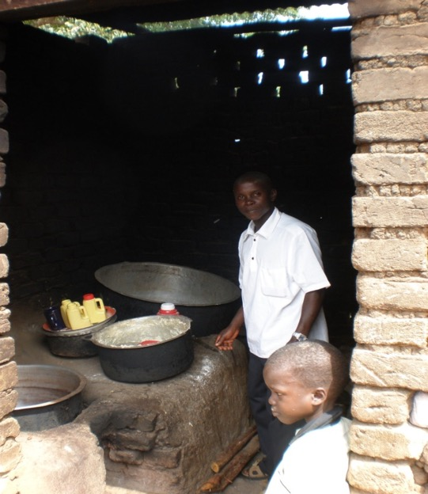
Enhancing soil carbon
Land management techniques
No till agriculture
Use of cover crops to cover soil post
harvest
Using species of plants with great
root mass
Grow more traditional rather than
genetically modified crops and animals
Address timber use, such as fuel
efficient stoves
Vasandham Society in Tamil Nadu are encouraging farmers to grow traditional grains such as millet and not wheat, as more suited to drier climate, keeping traditional chickens rather than exotic breeds.

Slide 18
WATER RESOURCES – anecdotal
Country | 2007 survey | 30 year before
Cambodia | A drought year in 5 years No rain for 204 weeks in rainy season depletes reserves | Rare to have rains fail Supplementary water from well or pond in dry season
India | Fresh water 250 feet down Limited quantity of freshwater fish Water supplies polluted and cannot be drunk safely No rain at the right time | Fresh water 30 feet down Good fish supplies in local ponds and lakes Local ponds and lakes had freshwater safe to drink Received rain according to the season

Slide 19
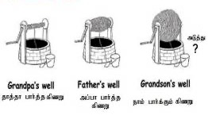
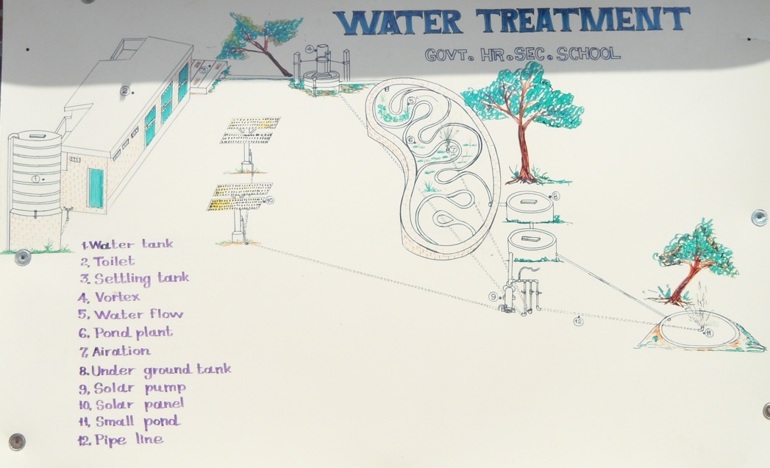
Water treatment as used at the Nadukuppam School, Tamil Nadu
Water treatment system uses a series of pond, each with different plants growing to provide specific filtration and then finally the water is returned to the soil in the vegetable and tree gardens at the school. The cartoon also from India explains very graphically what is happening to the water table.

Slide 20
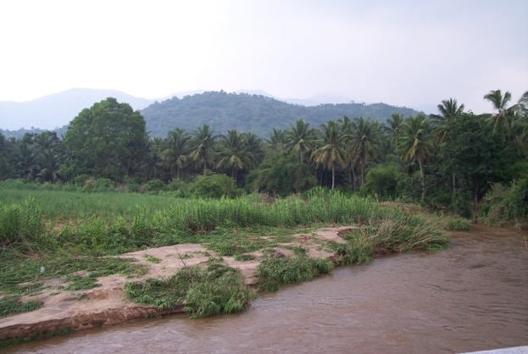
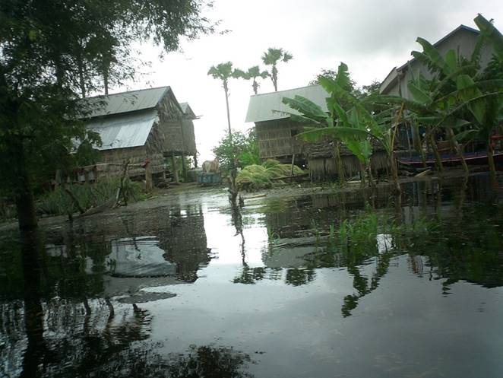
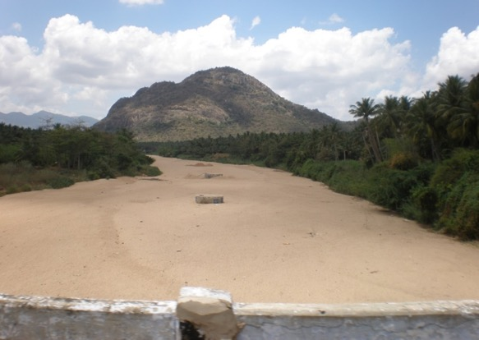
Climate change is having severe impacts on the land on which people rely to feed their families, such as extreme weather events of droughts, floods, changing rainfall pattern and rising temperatures means land becomes drier and less fertile land where fewer crops survive each planting season, poorer soil health, increased water scarcity and less nutritious harvest overall
Vaigai River in Tamil Nadu – a river and a road in the dry season
Floods in Cambodia

Slide 21
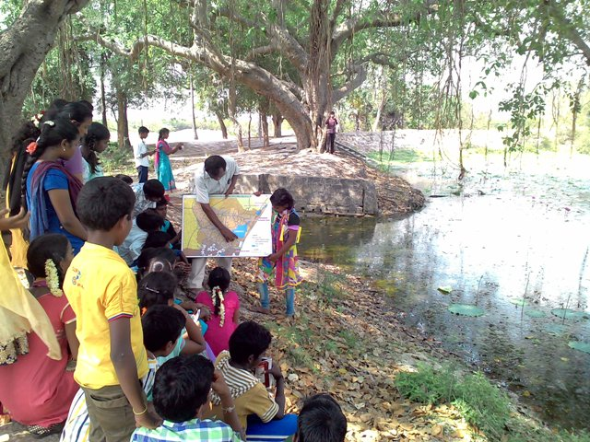
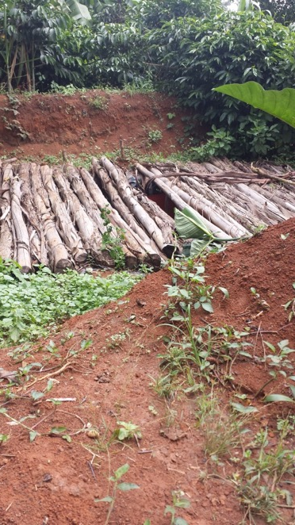
Water Management
Students in Tamil Nadu learning how to care for the natural waterways, which are open storage systems. Care needs to be taken to prevent encroachment by farmers planting crops and trees, or erecting fences to restrict access to the water.
  Underground water storage tanks in Uganda. one example is digging a hole, lining it and then covering to prevent animals and children from falling in.

Slide 22
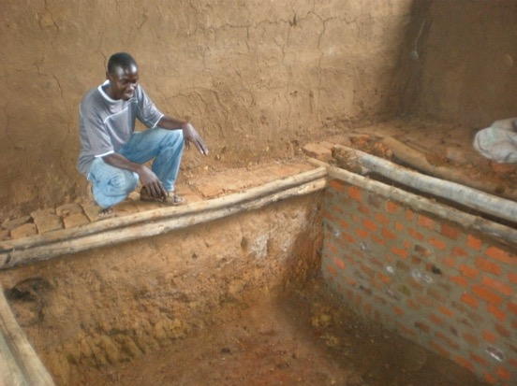
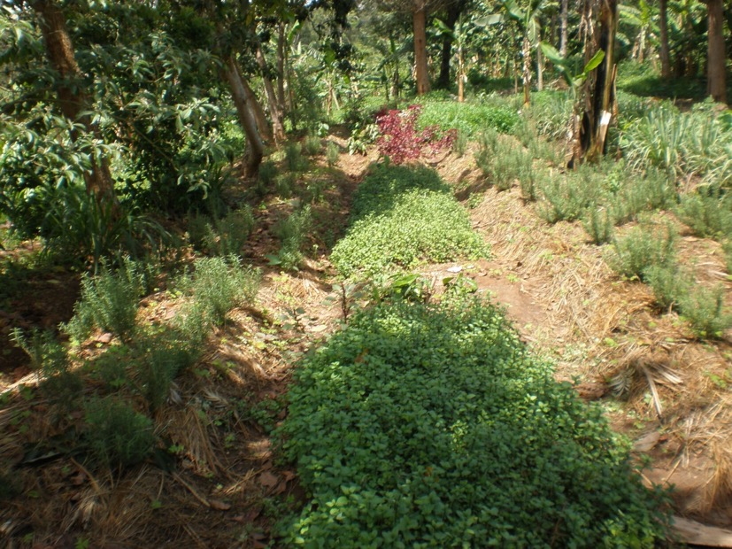
Still in Uganda, sometimes underground pits to store water are covered, providing place for food storage
Contour farming, using the land to hold water and plant on the low side for maximum water utilisation. Farmers with small parcels of land are encouraged to use sack gardens, vertical gardens and other devices to grow enough for the family’s needs.

Slide 23
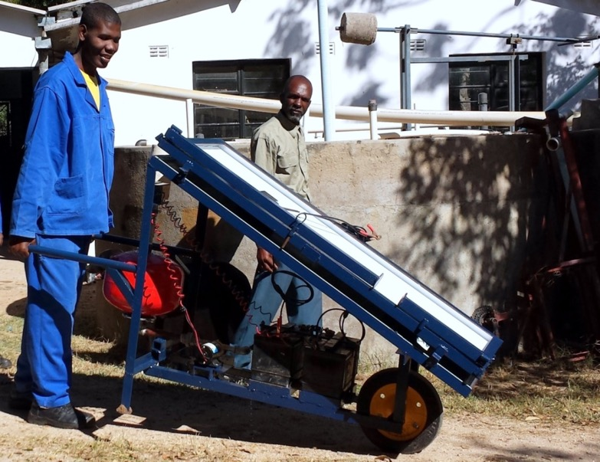
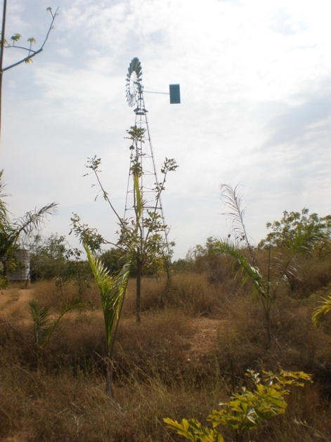
QSA’s completed project in Zimbabwe worked with the local partner to develop a way of accessing low level water from the river during the dry season. Accessing water from rivers using solar powered pumps means everyone can have access to water
QSA has been supporting communities to use solar panels in Cambodia and India, to increase street lighting, home lighting to enable students to do their homework safer than using kerosene lamps, and solar torches. As technology has increased, so has the knowledge and ability of such devices to be locally repaired and maintained.

Slide 24
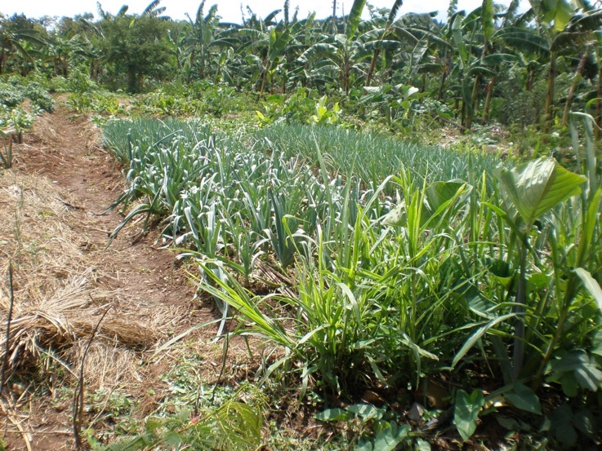
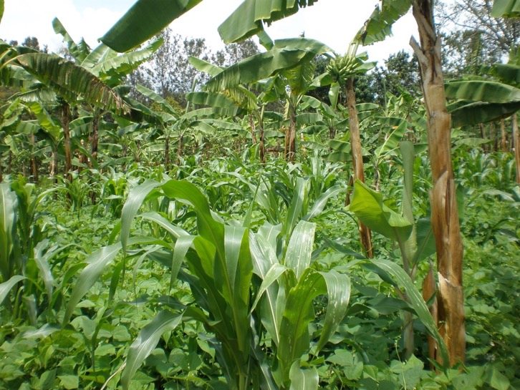
Soil Conservation
Intercropping to get maximum use from the soil
Significant crops are bananas, which in recent years, new varieties are being trialled, and then between the trees, other crops can be grown as bananas do not provide a wide canopy to restrict sunlight. Other examples would be climbing beans supported by sweet corn for example, provided the soil has been enriched by compost to cope with heavy demands, and adequate water resources close by, which is why contour ground work is so important.

Slide 25
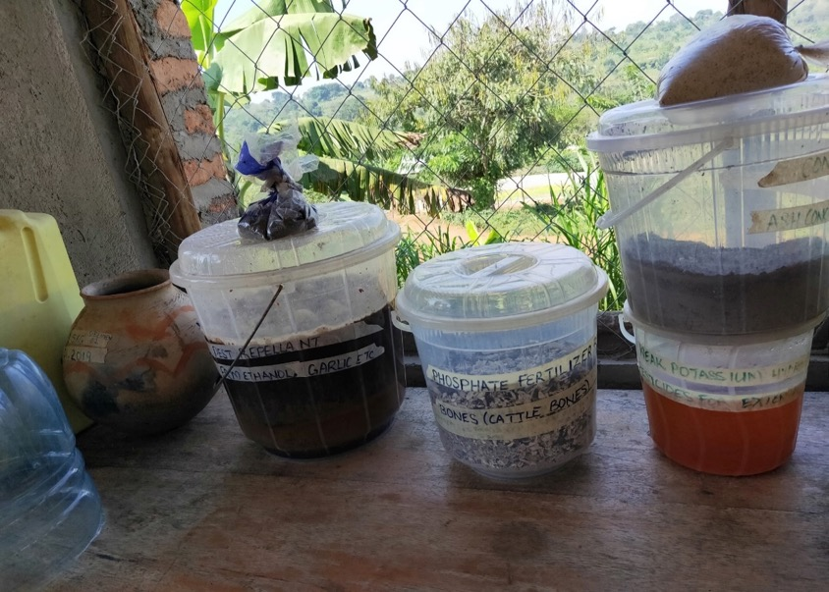
Minimal soil disturbance is done by mulching the gardens to minimize moisture loss and control of weed sprout at the same time decomposing mulch improves on soil fertility. In addition, land tilling is discouraged during dry spell to reduce loss of moisture
Fermented Bokashi Fertilizer – using organic fertilizers that farmers can make themselves using local ingredients.

Slide 26
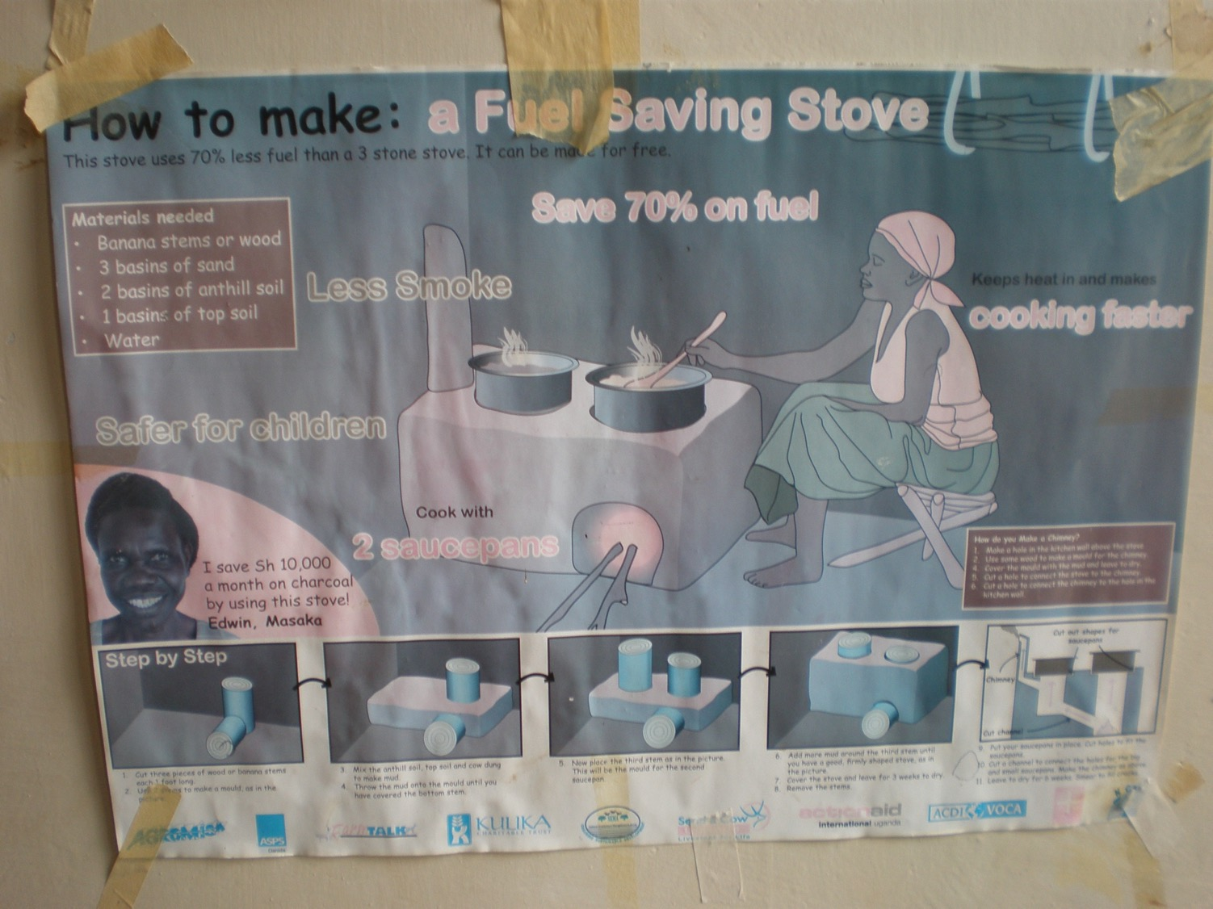

Slide 27
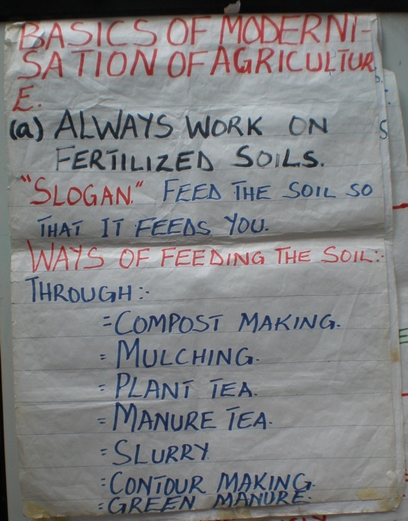
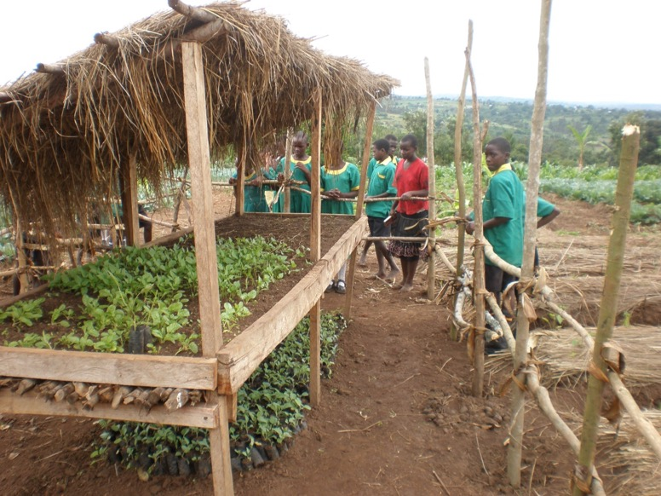
Training
Training to:
improve nutrition in the diet; and
how to grow food to increase yields

Slide 28
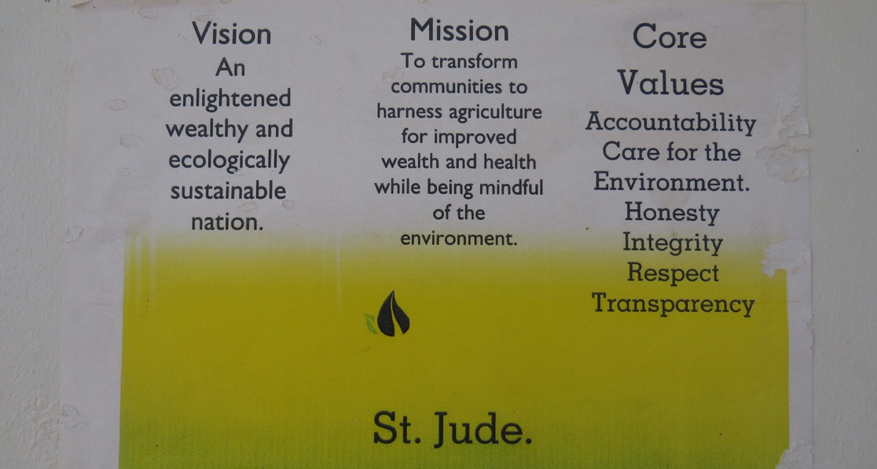
St Jude Family Projects, Uganda
From one Ugandan partner, St Jude, an example that climate change mitigation and adaptation is locally led and is an underlying principle of all their projects.

Slide 29
Project Theory of Change
Underlying principles are St Jude’s vision, mission and core values

Slide 30
To briefly explain what is a theory of change. It is a powerful thinking tool that helps to consider how intended changes can best be achieved, it shows the story of how the project will work to bring the change. The key word is change, as it is showing intended changes, not a sequence of events.
It can also be used help measure and draw out insights, evaluate and adapt our work as well as report on progress.
The core purpose of this approach is to help us come to a more fully shared understanding of how desired outcomes might best be achieved.
QSA assesses each of its projects in regards to manage environmental risks and impact, do no harm, protect and maintain the health, diversity and productivity of natural habitats, provide improved environmental outcomes. The project design must consider climate change in terms of adaptation (responding to impacts) as well as mitigation (addressing the cause).

Slide 31
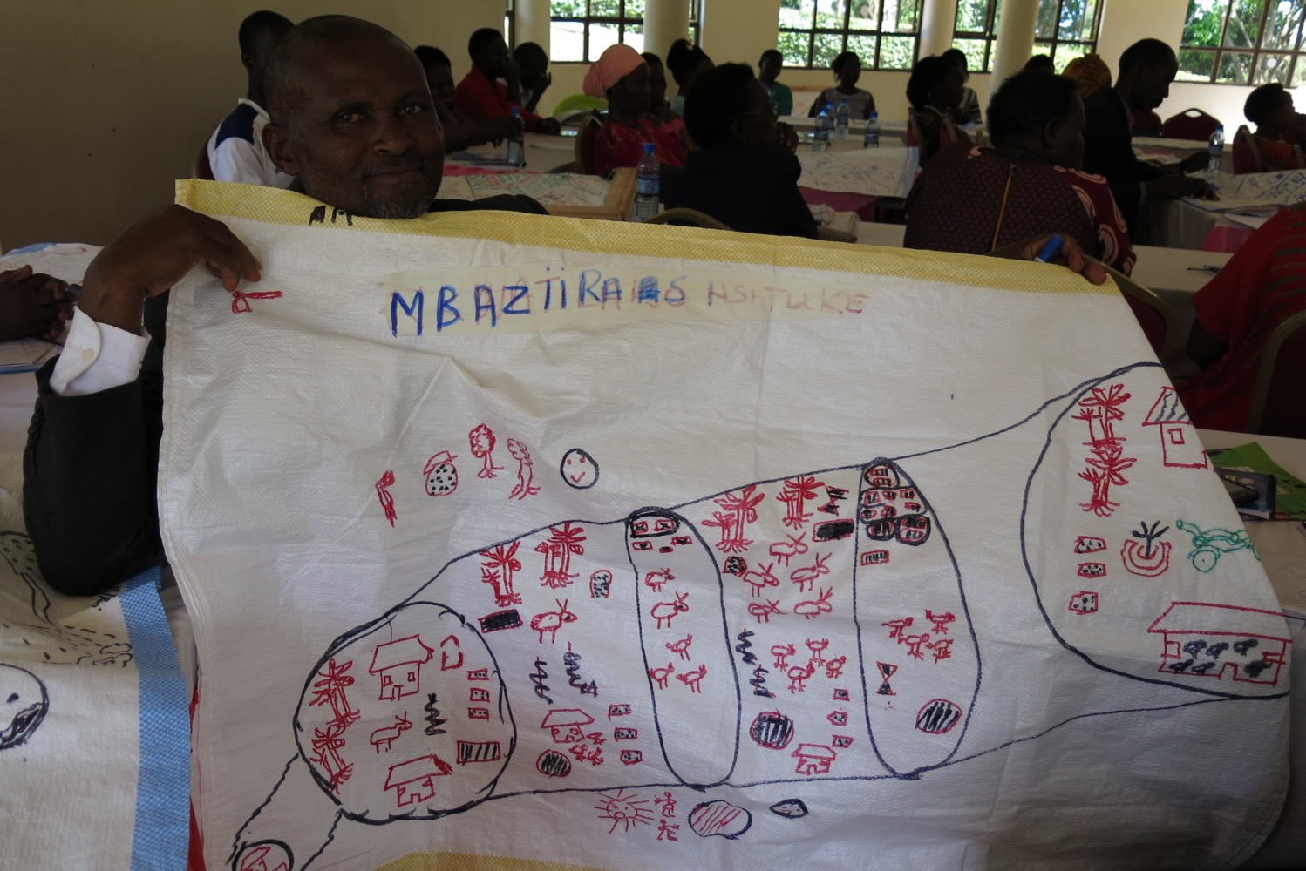
This shows a local farmer’s understanding of the project’s outcomes.

Slide 32
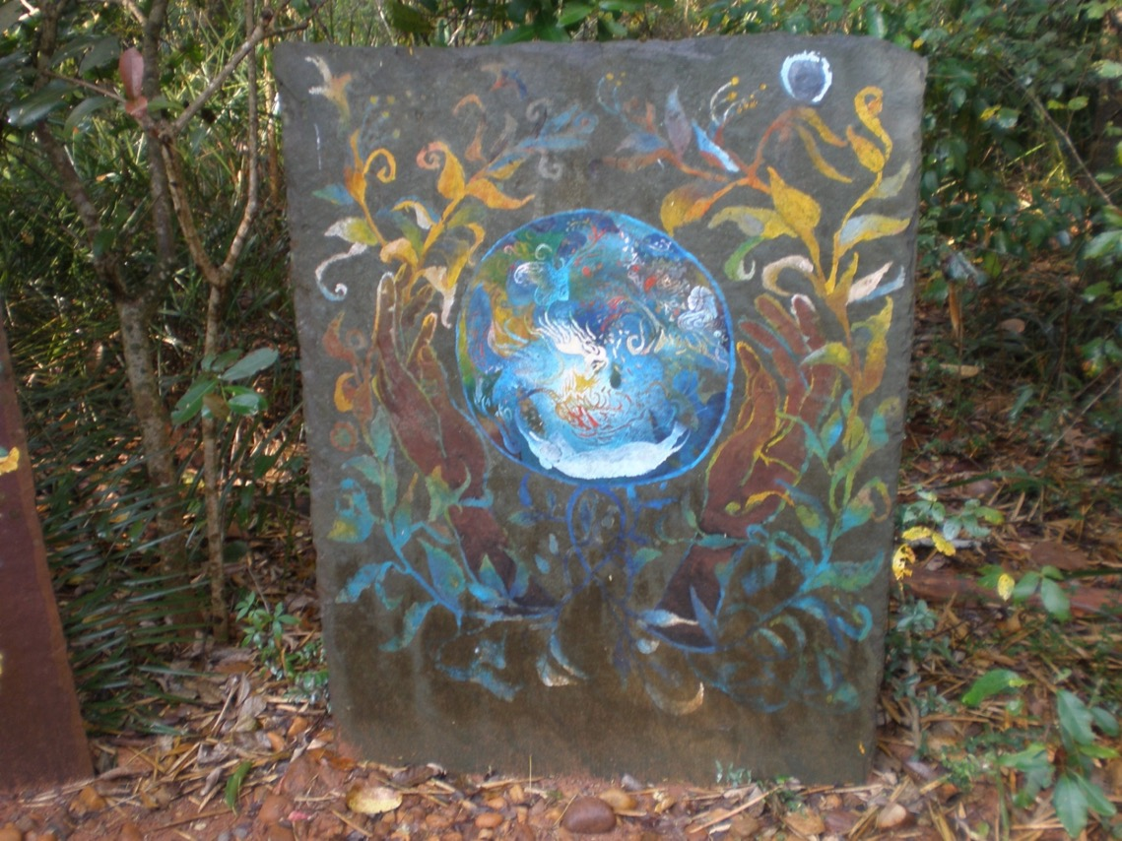
And finally, from Pitchandikulam Bio Resource Centre, Tami Nadu – the earth in caring hands. Thank you Friends.

Slide 33
Quaker Service Australia
www.qsa.org.au
Unit 14, 43-53 Bridge Road, Stanmore NSW 2048
administration@qsa.org.au
facebook.com/quakerserviceaustralia
02 8054 0400
Thank you Friends

